Slide 1


Kinder EHR
EHR information system in Health Care
HI-B-3: Information Systems in Health Care

Slide 2

Project output
Concept “Kinder EHR”
Website design
Technical architecture.
Live demo + sources
SUS evaluation

Slide 3

Website + EHR management system

Slide 4
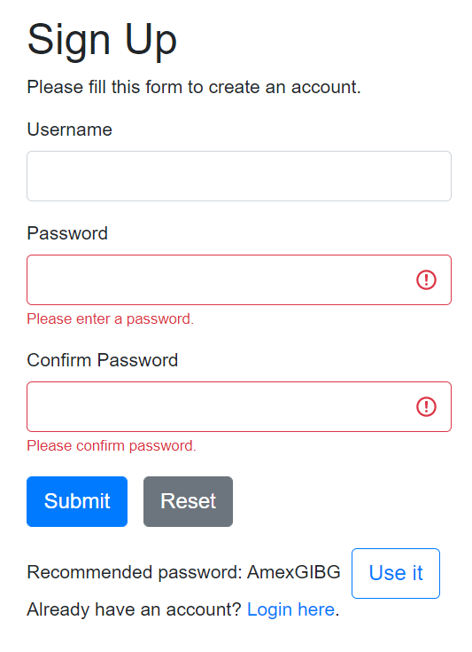
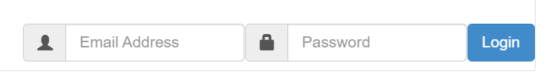
Sign-up page (Register.php)
Login form (Login.php)

Slide 5
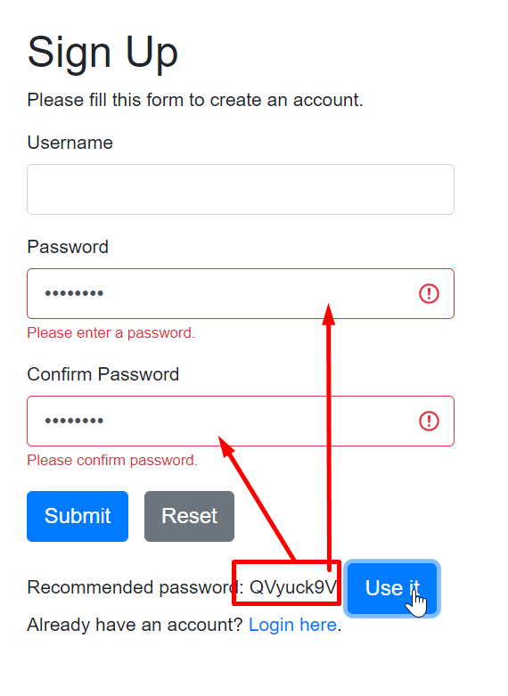
Strong password suggestion function

Slide 6
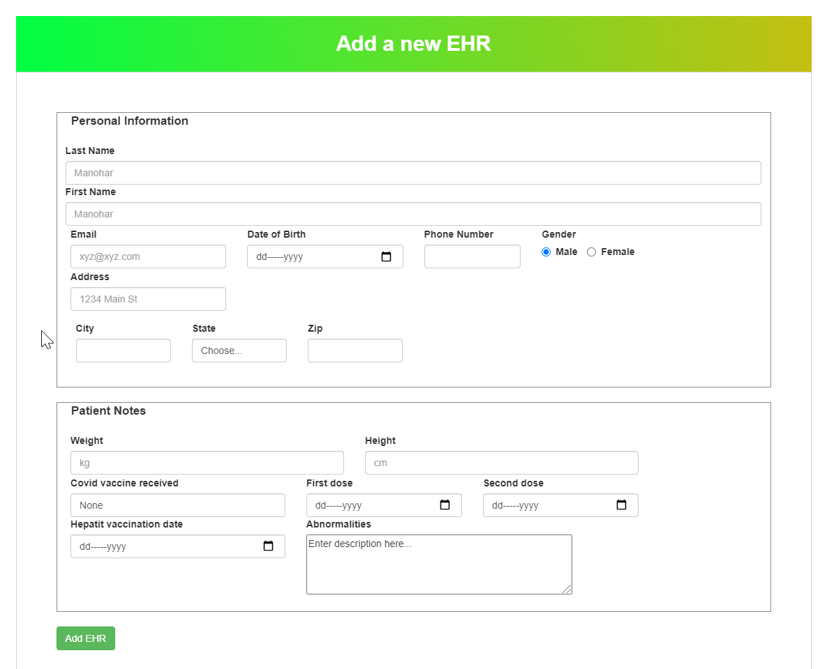
Create EHR
index.php
ehrManager.php

Slide 7
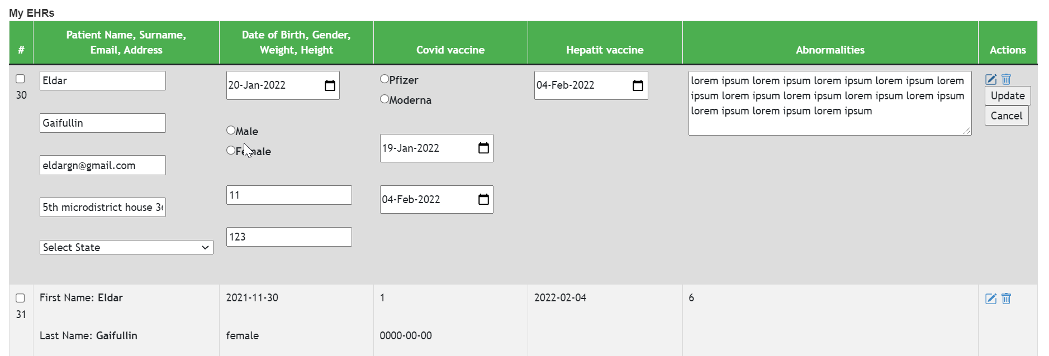
CRUD EHR data
My EHRs table
Each doctor can only see his/her list of patient EHR
index.php
ehrManager.php

Slide 8

UI evaluation
SUS score method
10-question survey Google Forms
2 respondents
SUS score = 87.5

Slide 9

Thank you for attention
Live demo - http://prazdnik.kg/ehr

